Slide 1
The “AI ISSUE”
Zine
Miranda Lachniet — GD 491

Slide 2
Going into this class, I had a general idea of how AI worked. Taking this class opened my eyes to the practical realities of things like data centers, the materials used to make our phones, and the socio-political role of AI. In all of my design responses, I wanted to focus on moments of clarity in this class. Based off our class conversations, as well as conversations outside of class, I felt that communicating these issues was an important priority for us as designers. For my final design, I merged everything from this class and my design responses into one piece of physical media.

Slide 3
Project Philosophy and Intent
Approachability
Making an approachable project was my foremost consideration gong into this project. I felt it was better to meet people where they were at and convey this information, than to push them away immediately.
Part of this was appealing to aesthetic. The cover is meant to be vague and appealing to magazine styles, like Vogue, hence “issue.” I wanted the dover and contents to be eye catching and appealing to anyone
Accessibility
The other key element in my approach was breaking down AI, and its issues, in an easily comprehensible way to the average person who is unfamiliar with the complexities of AI.

Slide 4

Initial plans
My first step was to identify which issues pertaining to AI I wanted to focus on. Initially, I wanted this project to have many subjects, but I realized that my intent of approachability and accessibility conflicted with this goal. I decided, after conversations in class, with friends and family, and online, that I wanted to focus on educating people about LLM’s specifically, because it’s the most common form people interact with and associate AI with.
I wanted people to understand how AI “thinks” and gets the answers it gets, so that they can use that framework going forward when using and engaging with AI. The intent of this project is not to teach everything there is to know, but to set people up with the curiosity, questions, and resources to go off on their own and investigate AI, and hopefully be critical of their own AI usage.

Slide 5
Beyond educating people about LLM’s, I also wanted to hone in the two issues which I thought were most important, those being:
AI Sycophancy
Environmental Impact
&
This is where I began to incorporate Katie Singer’s substack into the research portion.

Slide 6
Development
Distribution and reception heavily influenced the direction of the project. Initially, this was going to be an interactive website, but I found that difficult to navigate and wanted to appeal to the sort of person who wouldn’t navigate to a website about AI in the first place. I was inspired by the physical media being made for design responses in this class, and decided to pivot to an easily distributable and readable mode of communication: zines. Zines can be left around and catch the eye of possible readers, and could be left around campus. My hope with a zine is that someone would be curious, pick it up, and learn something, or at least cause them to think critically, about AI.

Slide 7
Stages of development
Because the core philosophy and intent of the project remained the same, I was able to incorporate the work I did in class throughout the project. I merged my first idea of a website dissuading AI use co opting the aesthetics of sleek AI websites with eye catching memes that make fun of perceptions about AI. Then, I began pulling quotes from Katie Singer which would best elevate my point. While I did this, I researched AI from a diverse array of resources to fact check my writing.

Slide 8
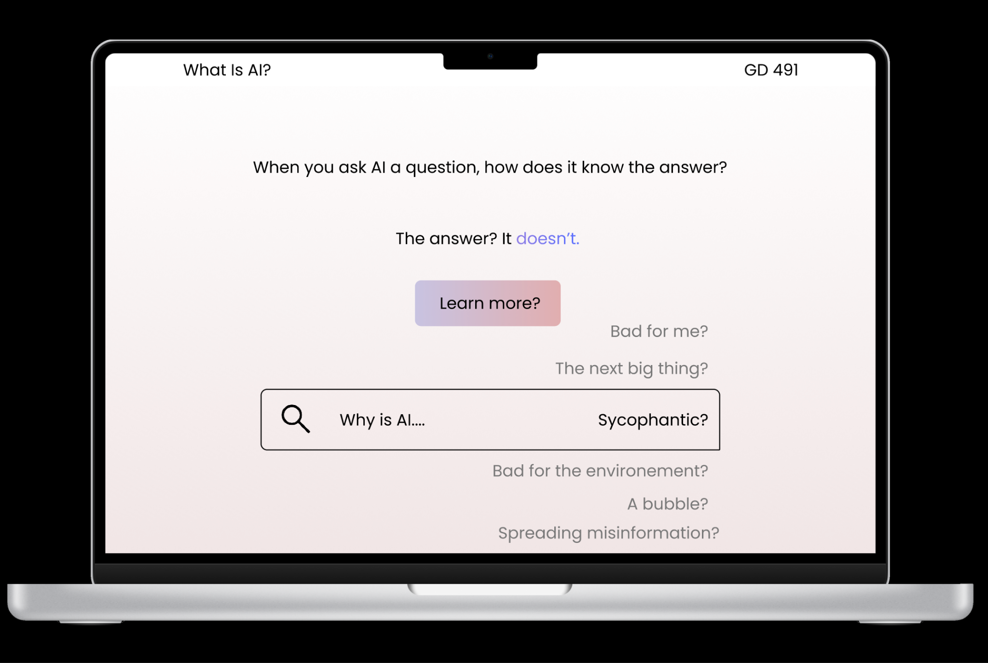

Slide 9
Optics
Optics are an important but difficult part in making political change, like the sort of change necessary for preventing the issues coming from AI. Confronting hard truths can be difficult and put people off from the movement. However, passivity can fail a movement as well. In this project, I tried to a balance between coddling readers to the point of futility and being harsh to the point where they wouldn’t want to engage with these issues in the first place. Addressing the AI issue requires a level of bluntness and forwardness, because it is causing tangible harm, but I think there is a way to be assertive about the truth without coming off as harsh or judgmental.

Slide 10
The issue of distilling
One immediate issue with approaching AI with people unfamiliar with AI who may uncritically use it, is that it is difficult not to come off as judgemental or didactic. Because of the inherent level of harm in AI use, in the writing and rewriting phases I tried to continually approach the project from the perspective of someone who uses but doesn't necessarily understand the harms of AI. While the damage done by AI use are important, I wanted this project to be a judgementless feeling appraisal of the value of AI that will cause people to begin looking into and critically thinking about AI, without being turned off by shame or embarrassment. .

Slide 11
In this class, we focused on many of the issues surrounding AI. One issue with discussing AI is that it is inherently a conversation about capitalism. Under a capitalist system, technologies are developed by and for the profit of the ruling class. The way these technologies are used, and the impact they have, is determined by a handful of powerful people trying to make a profit. AI is a manifestation of the destructive and subsuming properties of late stage capitalism, where building data centers that will likely one day be abandoned, and destroying the environment, is a means to a quarterly end. The units we worked on reflect this, whether its social or environmental or political. When approaching this project, I didn’t want to think of it as just an AI issue, but a larger structural issue. While these structural critiques are not the focus of the text, this understanding was important in empathizing with users.

Slide 12
The “AI ISSUE”
Zine
Thank you for your time! Comments, questions, or feedback?

